Slide 1
Software Architecture
Zikun Deng
zkdeng@scut.edu.cn
zkdeng.org

Slide 2


Slide 3
Motivation of this course
Be able to think on the level of software architecture in all the phases of software engineering
Algorithm level
Programming (language) level

Slide 4

教科书和参考书
教科书:
  软件架构实践（第4版），L. Bass, P. Clements, and R. Kazman，机械工业出版社，2025年
参考书:
  软件构架实践（第3版），L. Bass, P. Clements, and R. Kazman，清华大学出版社(2013)
  软件体系结构，林荣恒 吴步丹 金芝，中国工信出版集团，人民邮电出版社2016年

Slide 5
考试与成绩
期末考试 70%
平时成绩 30%
  大作业
  课堂考勤

Slide 6
Major Contents
Introduction of software architecture
  what, why, contexts of software architecture
Quality attributes
  Availability, modifiability, performance, security, testability, and usability
  Architecture pattern & tactics
  QA analysis and case study
Architecture in the life cycle
  Requirement, design, implementation, test, and evaluation

Slide 7
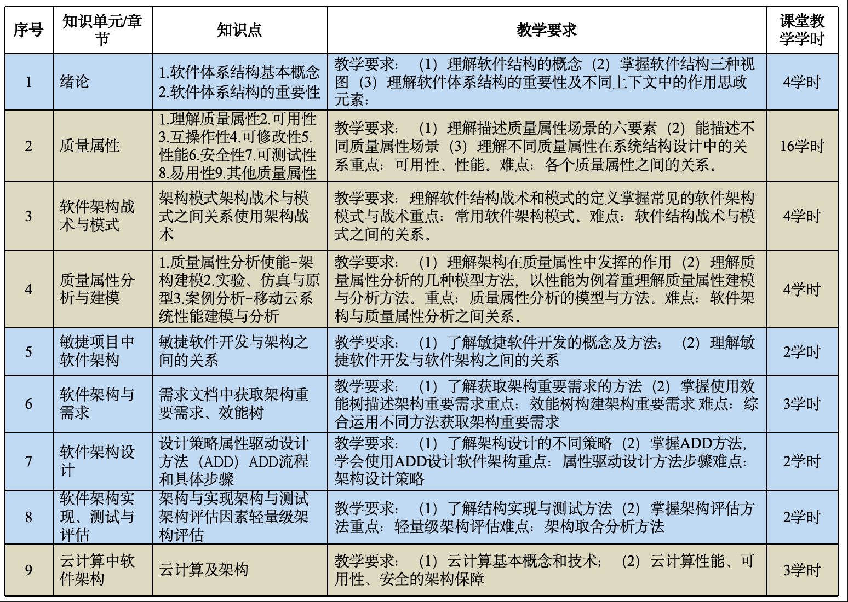
Major Contents

Slide 8
Chapter 1
What is Software Architecture?

Slide 9
阿里双十一——超大规模电商系统
国家需求背景：支撑数字经济的发展，构建世界领先的电子商务基础设施，应对全球罕见的瞬时高并发挑战。
架构挑战：
  极高的并发量：峰值流量可达每秒数十万甚至上百万笔订单。
  系统的稳定性与高可用：必须保证7x24小时不间断服务，任何宕机都是不可接受的。
  快速扩容与弹性伸缩：流量在一天内波动巨大，需要系统能自动“呼吸”。
核心架构思想与风格：
  微服务架构：这是最关键的架构演进。将庞大的单体应用拆分成数百个微服务（用户、商品、订单、支付、库存等）。好处：解耦、独立开发部署、故障隔离（一个服务出问题不会导致整个系统崩溃）、技术栈灵活。
  服务网格：用于处理服务间的通信、熔断、限流、监控，代表技术如Dubbo（阿里开源的高性能RPC框架）和Sentinel（流量卫兵），这是微服务架构的“神经网络”。
  异地多活：在多个城市建立数据中心，同时提供服务。优势：任何一个机房断电、断网，流量可以瞬间切换到其他机房，用户几乎无感知，实现了极高可用性。
  数据分片与弹性计算：数据库采用分库分表（如TDDL），计算资源采用云原生弹性伸缩，在流量洪峰到来前自动扩容，结束后释放资源以节约成本。
Notes:
淘宝千万级并发架构的十四次演进 - 知乎 (zhihu.com)

Slide 10


Slide 11
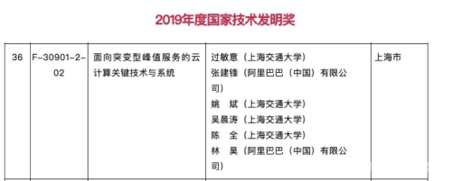

Slide 12
北斗卫星导航系统
国家需求背景：国家时空信息安全，摆脱对国外导航系统的依赖，为国防、交通、金融等关键领域提供自主可控的“中国坐标”。
架构挑战：
  极高的可靠性：系统必须万无一失，长期稳定运行。
  复杂的分布式协同：由空间段（多颗卫星）、地面段（主控站、注入站、监测站）和用户段（终端）组成，需要精准同步与协同。
  实时性：从卫星发出信号到用户接收定位，必须在极短时间内完成。
核心架构思想与风格：
  分布式系统架构：这是一个经典的、物理上分散但逻辑上统一的超大型分布式系统。
  C/S与B/S混合架构：
    用户终端与卫星之间是客户端/服务器架构（卫星提供服务，终端消费服务）。
    地面控制中心与卫星之间，以及各地面站之间，是严密的内网系统，但其数据交互和管理模式也借鉴了B/S的集中监控与分发思想。
  容错与冗余设计：关键部件（如原子钟）和地面站都有多重备份，软件系统也采用冗余设计，确保单点故障不影响全局服务。
  严格的分层架构：从底层的硬件、操作系统到上层的定轨、时间同步、报文通信等应用软件，层次清晰，接口明确，保证了系统的可维护性和可靠性。
Notes:
中国高精度位置网及其在交通领域的重大应用 国家科技进步一等奖

Slide 13
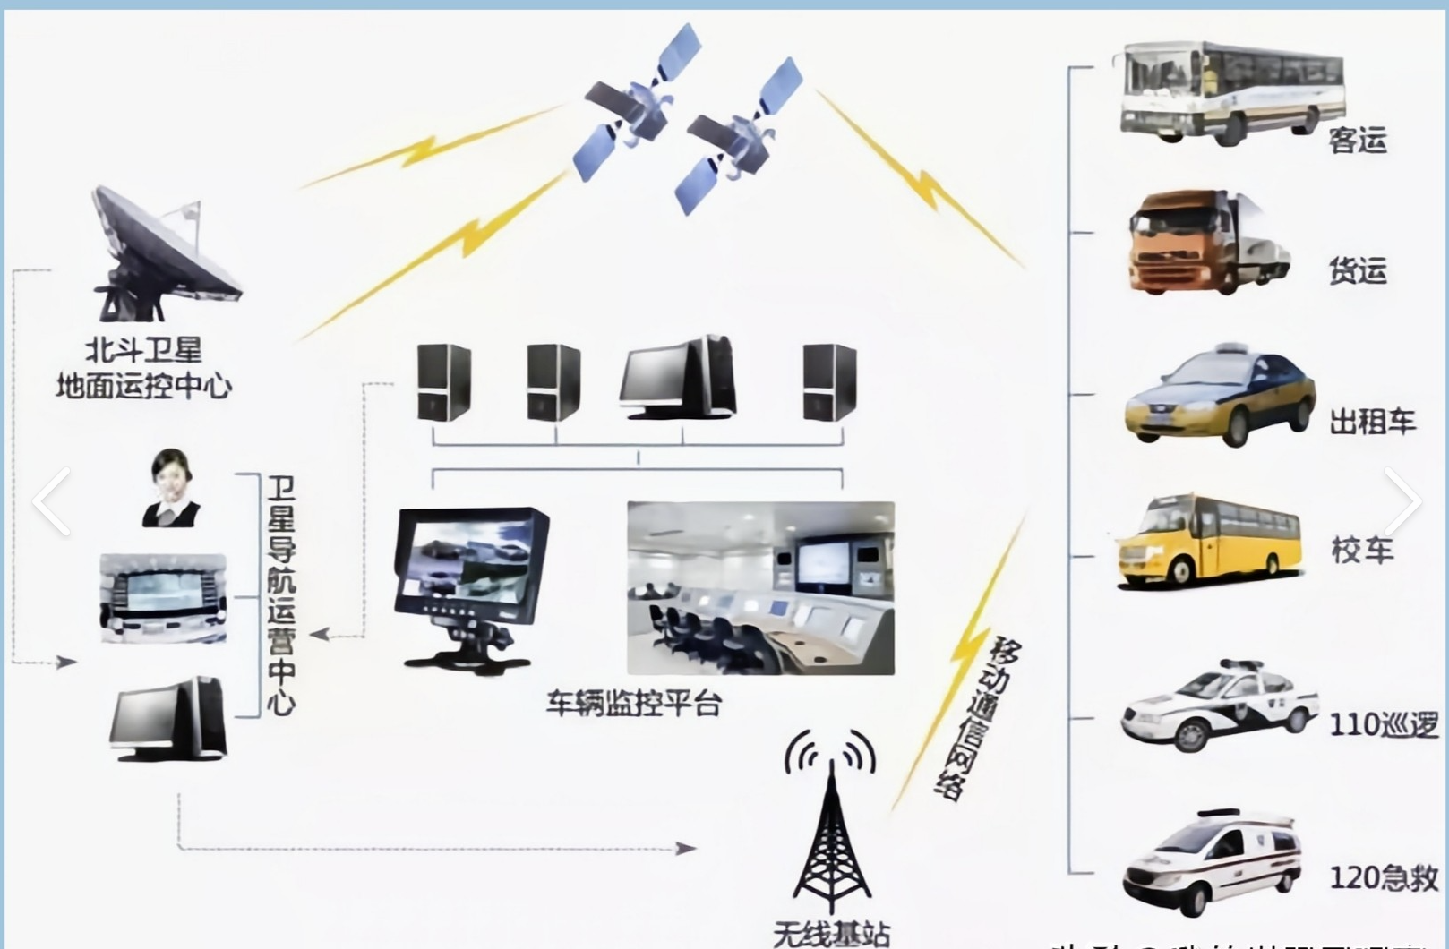
中国高精度位置网及其在交通领域的重大应用
国家科学技术进步奖一等奖

Slide 14
12306售票系统——从集中式到混合云的超复杂计算系统
国家需求背景：解决“世界上规模最大的实时交易系统”难题，保障民生，应对春运等人类最大规模的周期性迁移。
架构挑战：
  极端的并发与锁冲突：全国人民同时抢票，对同一个车次座位资源的读写冲突极大。
  复杂的业务逻辑：票源分配（全程票、区间票）、候补等机制。
  防止恶意抢票和爬虫。
核心架构思想与风格：
  混合云架构：这是12306演进的成功关键。将核心的票务库存业务（需要强一致性）放在昂贵的IBM大型机（稳态）上保障可靠性和事务，将查询、用户登录、订单等业务部署到阿里云（敏态）上利用其弹性能力应对流量高峰。
  异步化与读写分离：采用消息队列（如MQ）将下单流程异步化，避免长时间锁住库存。大量的查询请求被路由到读写分离的从数据库，减轻主库压力。
  内存计算：将热点数据（如车次、座位信息）缓存到内存数据库中（如Redis），极大提升访问速度。
  智能调度与算法：采用分布式库存分库分表，将同一趟列车的不同座位段分配到不同的数据库节点，减少冲突。后端算法智能计算票额分配。

Slide 15
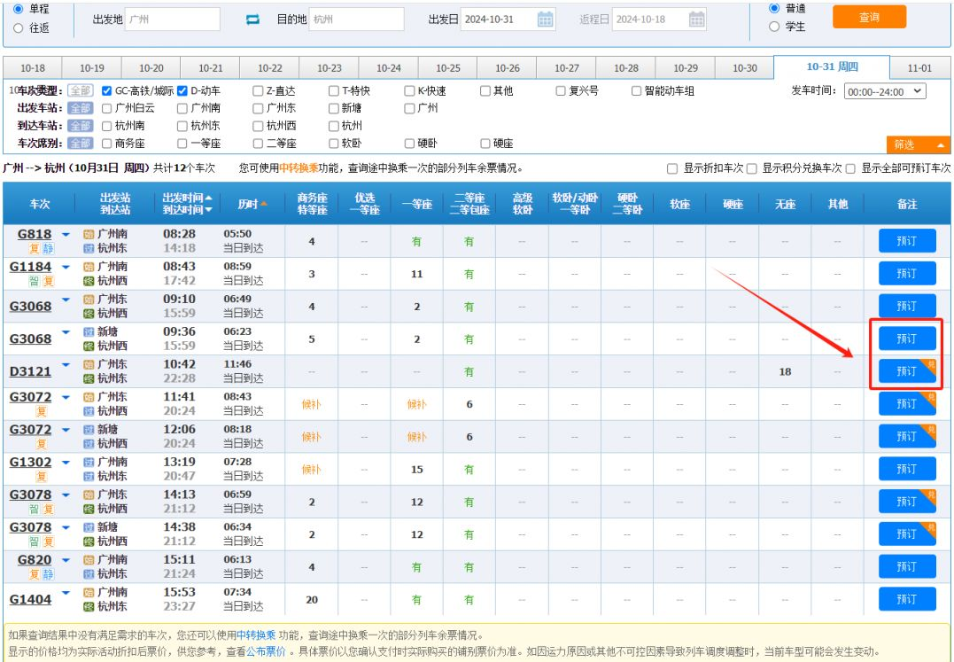
中国铁路客票发售和预订系统
国家科技进步一等奖

Slide 16
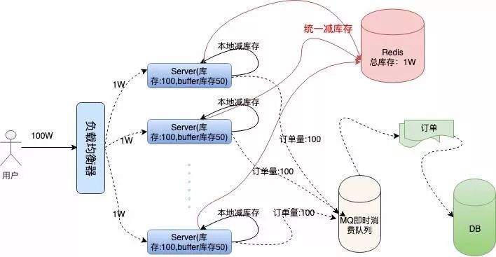
Notes:
科技进步二等奖

Slide 17
What is Software Architecture?
The software architecture of a system is the set of structures needed to reason about the system, which comprise software elements, relations among them, and properties of both.

Slide 18
Architecture Is a Set of Software Structures
A structure is a set of elements held together by a relation.
Software systems are composed of many structures, and no single structure holds claim to being the architecture.
There are three important categories of architectural structures.
  Module
  Component and Connector
  Allocation

Slide 19
Module Structures
Some structures partition systems into implementation units, which we call modules.
Modules are assigned specific computational responsibilities, and are the basis of work assignments for programming teams.
In large projects, these elements (modules) are subdivided for assignment to sub-teams.

Slide 20
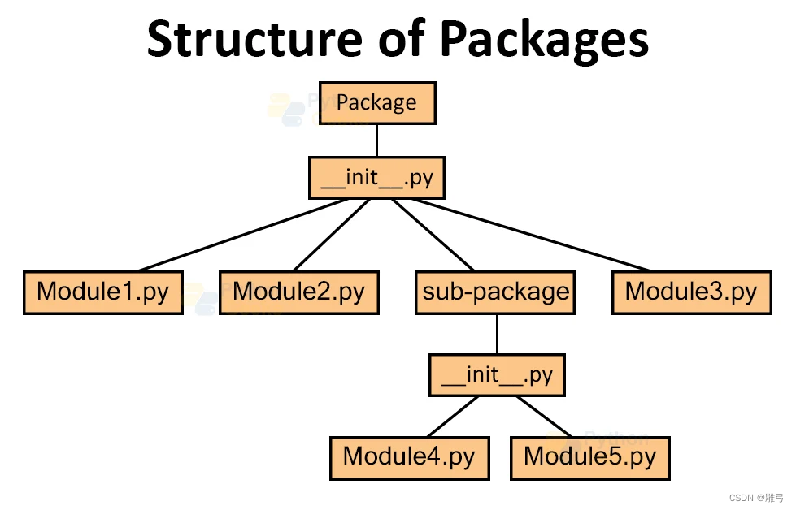

Slide 21
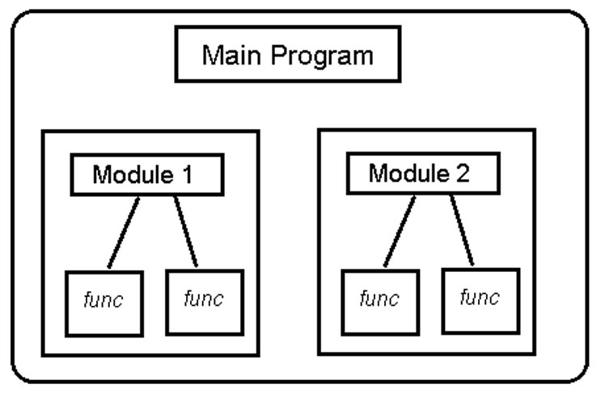

Slide 22
Component-and-connector Structures
Other structures focus on the way the elements interact with each other at runtime to carry out the system’s functions.
We call runtime structures component-and-connector (C&C) structures.
A component is always a runtime entity.
  In SOA, the system is to be built as a set of services.
  These services are made up of (compiled from) the programs in the various implementation units – modules.

Slide 23
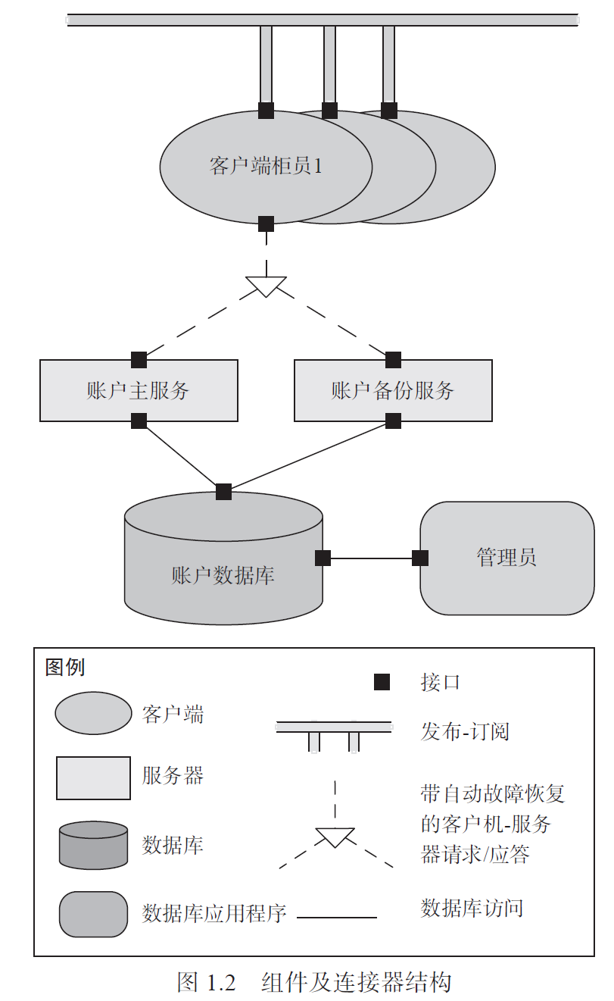

Slide 24
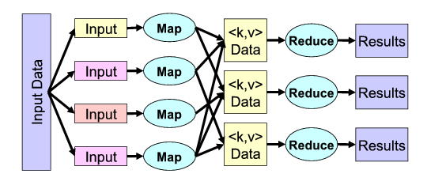

Slide 25
Allocation Structures
Allocation structures describe the mapping from software structures to the system’s environments
For example
  Modules are assigned to teams to develop, and assigned to places in a file structure for implementation, integration, and testing.
  Components are deployed onto hardware in order to execute.

Slide 26
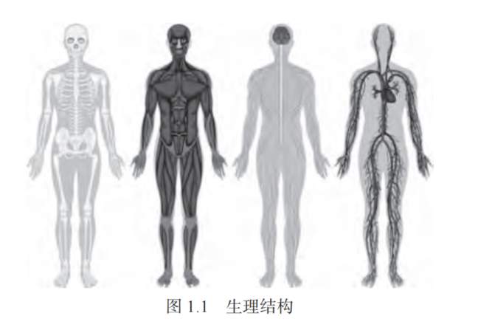

Slide 27
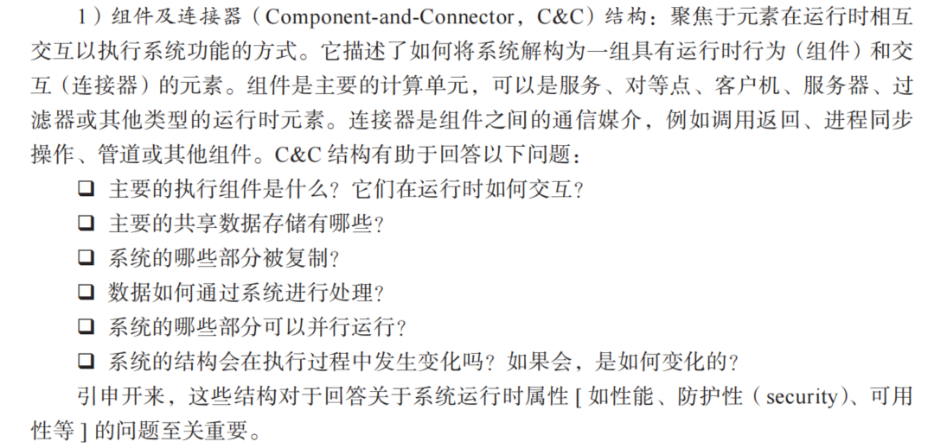

Slide 28
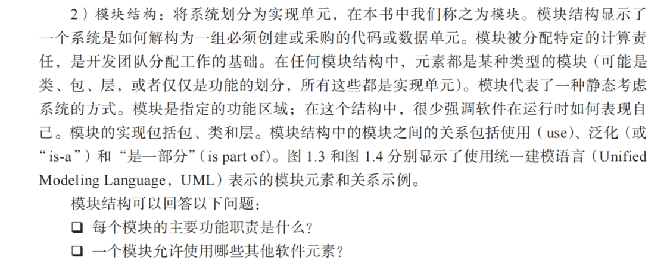
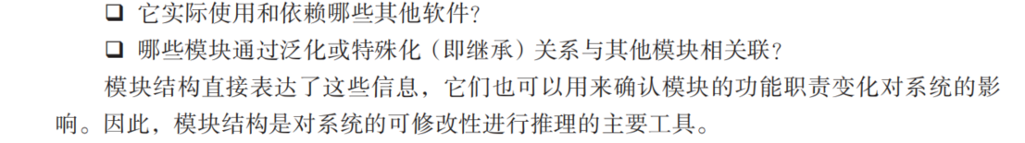

Slide 29
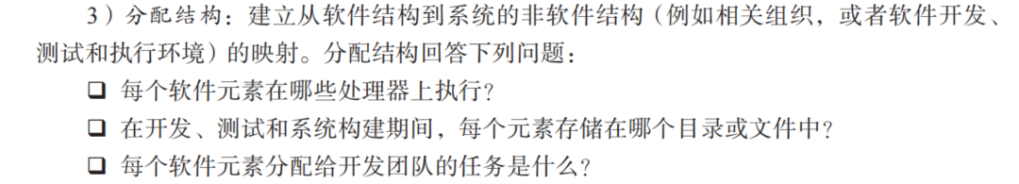

Slide 30
Which Structures are Architectural?
A structure is architectural if it supports reasoning about the system and the system’s properties.
The reasoning should be about an attribute of the system that is important to some stakeholder.
These include
  functionality achieved by the system
  the availability of the system in the face of faults
  the difficulty of making specific changes to the system
  the responsiveness of the system to user requests,
  many others.

Slide 31
泰坦尼克
它被称为“永不沉没的巨轮”，但却在首航中沉没了。很多人归咎于冰山或是船长的大意，但一个至关重要的工程学原因常常被忽略：船体的舱室设计。
最初的设计师提出了一个“三舱室失效”的安全架构：即使船体前三个舱室同时进水，船也能保持漂浮。这个设计在当时是极其先进的，远超安全标准。因此，人们坚信它“永不沉没”。
但悲剧在于，冰山撕裂的伤口跨越了六个舱室。这个灾难超出了它最初设计的“系统架构”所能承受的“最大负载”。它的架构无法应对这种“异常用例”。
Notes:
这就好比我们开发一个软件。如果我们只考虑了“理想情况”下的用户访问量（三个舱室进水），而没有为“突发流量”、“恶意攻击”或“数据爆炸”（六个舱室进水）设计一个健壮的系统架构（比如微服务隔离、负载均衡、容灾备份），那么我们的“软件巨轮”也可能在首次上线时就遭遇“冰山”而崩溃。
软件体系结构，就是要在造船之前，就规划好舱室如何隔离、管道如何铺设、救生艇放在哪里。它不是为了增加麻烦，而是为了在风暴和冰山面前，保住整条船的价值。

Slide 32
巴黎的地下迷宫
巴黎的地下有什么吗？除了地铁，那里还有一个巨大的、错综复杂的“地下城市”：遍布着古老的采石场隧道、废弃的地下墓穴、几百年前的下水道、以及密密麻麻的现代管线（光纤、电缆、燃气）。
为什么这么乱？因为巴黎不是在一天建成的。人们总是在原有的系统上，不断地打补丁、增加新功能：中世纪需要采石建教堂，19世纪需要解决卫生问题修建下水道，20世纪要通地铁，21世纪要铺光纤。每一个决策在当时都是最优解，但数百年的“迭代开发”和“紧急修复”累积下来，形成了一个无人能完全搞清的、极其脆弱和危险的“遗留系统”。现在，任何想在地下进行的新的工程都变得异常困难和昂贵。
Notes:
这就是技术债的终极体现！很多软件项目也是如此。我们为了赶工期（业务需求），选择了最快的实现方式，忽略了代码结构和系统设计（没有架构）。一年又一年， patch on patch，最终系统变成了一个“黑盒”：没人敢动，动一动就出问题，新功能加不进去，维护成本高到惊人。
软件体系结构课程，就是要教大家如何避免建造这样一个“地下迷宫”。它教我们如何用清晰的“蓝图”（架构图）和“规范”（设计原则）来构建系统，让系统不仅满足当前需求，更能优雅地应对未来的变化，降低长期的“维护成本”。

Slide 33
Architecture is an Abstraction
An architecture specifically omits certain information about elements that is not useful for reasoning about the system.
The architectural abstraction lets us look at the system in terms of its elements, how they are arranged, how they interact, how they are composed, and so forth.
This abstraction is essential to taming the complexity of an architecture.

Slide 34
Every System has a Software Architecture
But the architecture may not be known to anyone.
  Perhaps all of the people who designed the system are long gone
  Perhaps the documentation has vanished (or was never produced)
  Perhaps the source code has been lost (or was never delivered)

Slide 35
Architecture Includes Behavior
The behavior of each element is part of the architecture insofar as that behavior can be used to reason about the system.
This behavior embodies how elements interact with each other, which is clearly part of the definition of architecture.
Notes:
Syn. vs. asyn

Slide 36
Structures and Views
A view is a representation of a coherent set of architectural elements, as written by and read by system stakeholders.
A structure is the set of elements itself, as they exist in software or hardware.
In short, a view is a representation of a structure.
  For example, a module structure is the set of the system’s modules and their organization.
  A module view is the representation of that structure, documented according to a template in a chosen notation, and used by some system stakeholders.
Architects design structures. They document views of those structures.

Slide 37
Module Structures
Module structures embody decisions as to how the system is to be structured as a set of code or data units
In any module structure, the elements are modules of some kind (perhaps classes, or layers, or merely divisions of functionality, all of which are units of implementation).
Modules are assigned areas of functional responsibility.

Slide 38
Component-and-connector Structures
Component-and-connector structures embody decisions as to how the system is to be structured as a set of elements that have runtime behavior (components) and interactions (connectors).
Elements are runtime comopnents such as services, peers, clients, servers, or many other types of runtime element)
Connectors are the communication ways among components, such as call-return, process synchronization operators, pipes, or others.

Slide 39
Component-and-connector Structures
Component-and-connector views help us answer questions such as these:
  What are the major executing components and how do they interact at runtime?
  What are the major shared data stores?
  Which parts of the system are replicated?
  How does data progress through the system?
  What parts of the system can run in parallel?

Slide 40
MapReduce

Slide 41
Allocation structures
Allocation structures show the relationship between the software elements and elements in one or more external environments in which the software is created and executed.
Allocation views help us answer questions such as these:
  What processor does each software element execute on?
  In what directories or files is each element stored during development, testing, and system building?
  What is the assignment of each software element to development teams?

Slide 42
Structures Provide Insight
Each structure provides a perspective for reasoning about some of the relevant quality attributes.
For example:
  The module structure, which embodies what modules use what other modules, is strongly tied to the ease with which a system can be extended.
  The concurrency structure, which embodies parallelism within the system, is strongly tied to the ease with which a system can be made free of deadlock and performance bottlenecks.
  The deployment structure is strongly tied to the achievement of performance, availability, and security goals.

Slide 43
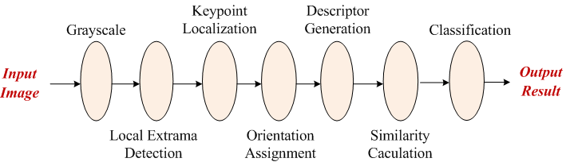
Computation Partitioning a simple example
0.1
0.2
0.2
0.3
0.2
0.15
0.1
1.89
1.42
0.84
0.71
0.47
0.24
0.42
0.31
0.28
0.55
0.55
0.86
0.55
0.44
0.28
Optimal Partitioning 0.28 + 0.55 + 0.84 + 0.2 + 0.3 + 0.2 + 0.15 + 0.1 + 0.31 = 2.93
Local Execution: 0.28 + 0.55 + 0.55 + 0.86 + 0.55 + 0.44 + 0.28 = 3.51
Remote Execution: 1.89 + 0.1 + 0.2 + 0.2 + 0.3 + 0.2 + 0.15 + 0.1 + 0.31 = 3.45

Slide 44
Some Useful Module Structures
Decomposition structure
The units are modules that are related to each other by the is-a-submodule-of relation.
It shows how modules are decomposed into smaller modules recursively until the modules are small enough to be easily understood.
Modules often have products (such as interface specifications, code, test plans, etc.) associated with them.
The decomposition structure determines, to a large degree, the system’s modifiability, by assuring that likely changes are localized.

Slide 45
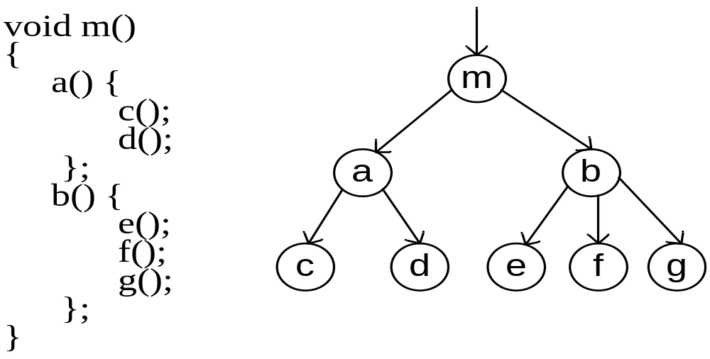
Decomposition structure: an example

Slide 46
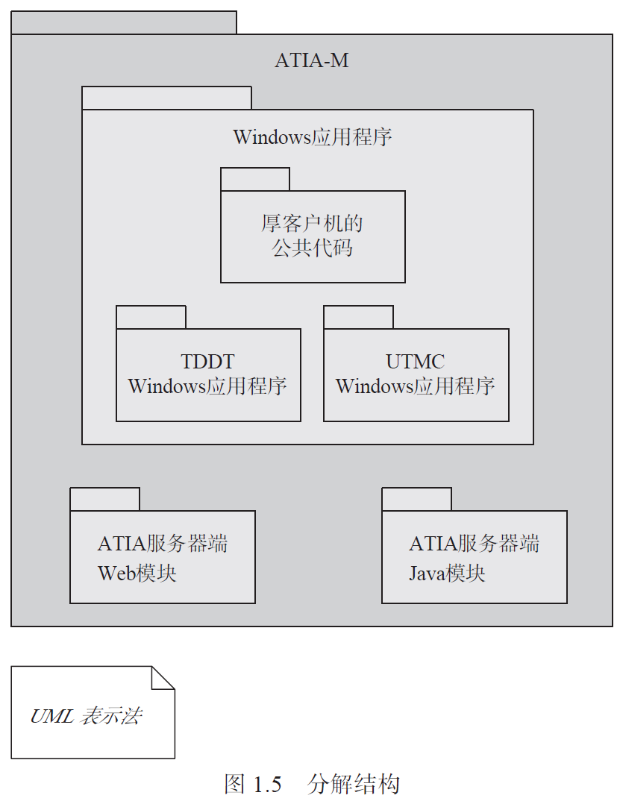
Decomposition structure: an example

Slide 47
乐高
乐高最神奇的地方是什么？是你可以用一套积木，按照说明书拼出一艘飞船，然后拆掉它，又能用同样的积木拼出一座城堡。
它的魔力来自于两个核心：
标准化的接口：每一块乐高积木上的凸起和孔洞都遵循极其精确的尺寸标准。这意味着任何两块乐高，只要它们是正品，就一定能严丝合缝地组合在一起。
可重用的模式：乐高官方和玩家社区总结了无数种“搭建模式”，比如如何砌墙、如何做铰链门、如何拼出一个球形。你不需要从零开始发明，可以站在巨人的肩膀上。
Notes:
标准化接口：对应我们课程要讲的模块化、接口设计、服务契约（如REST API）。定义了清晰的接口，不同的团队可以并行开发不同的模块，最后像乐高一样轻松组合。
可重用模式：对应我们将要学习的架构模式和风格，比如分层架构、微服务、事件驱动等。这些是前人总结的、经过验证的“最佳实践”和“搭建模式”，直接采用这些模式可以避免重复造轮子，大大提高开发效率和系统质量。

Slide 48
Some Useful Module Structures
Uses structure.
The units here are also modules, perhaps classes.
The units are related by the uses relation, a specialized form of dependency.
A unit of software uses another if the correctness of the first requires the presence of a correctly functioning version of the second.

Slide 49
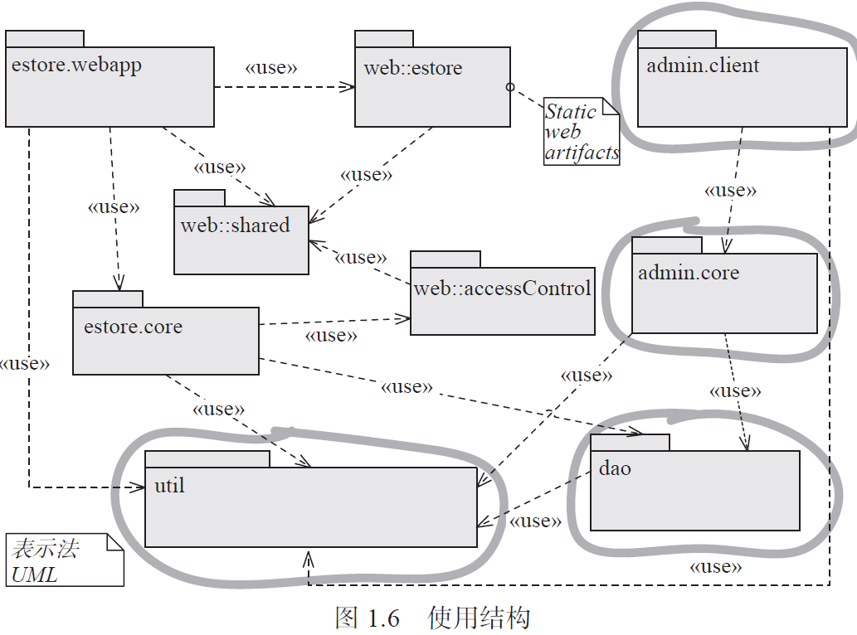
Notes:
并圈出了如果admin.client 模块存在，则必须在增量中出现的模块

Slide 50
Some Useful Module Structures
Layer structure
The modules in this structure are called layers.
A layer is an abstract “virtual machine” that provides a cohesive set of services through a managed interface.
Layers are allowed to use other layers in a strictly managed fashion.
  In strictly layered systems, a layer is only allowed to use a single other layer.
This structure imbues a system with portability, the ability to change the underlying computing platform.

Slide 51
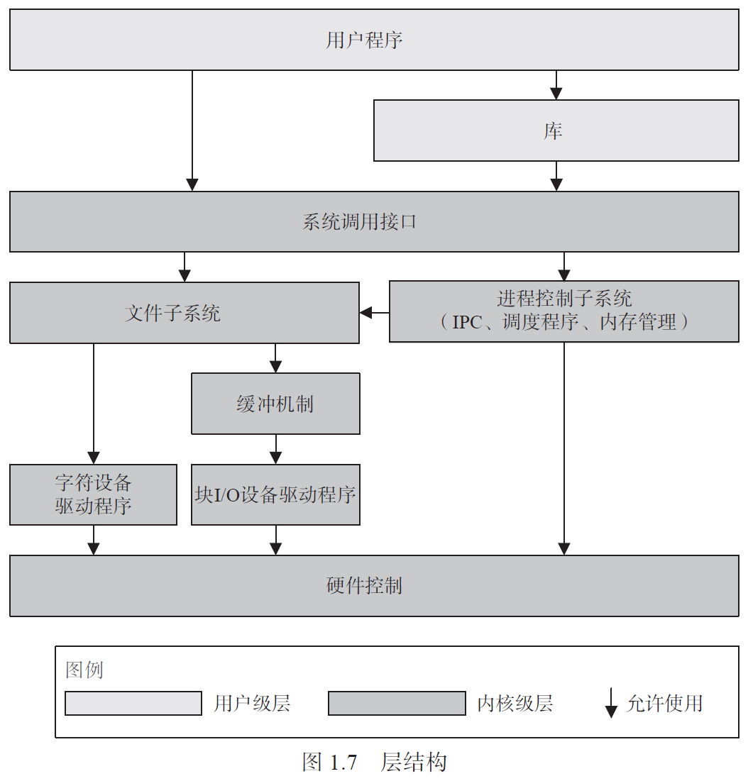
UNIX System V 操作系统的层结构

Slide 52
Some Useful Module Structures
Class (or generalization) structure
The module units in this structure are called classes.
The relation is inherits from or is an instance of.
Inheritance is a mechanism for code reuse and to allow independent extensions of the original software
The class structure allows one to reason about reuse and the incremental addition of functionality.

Slide 53
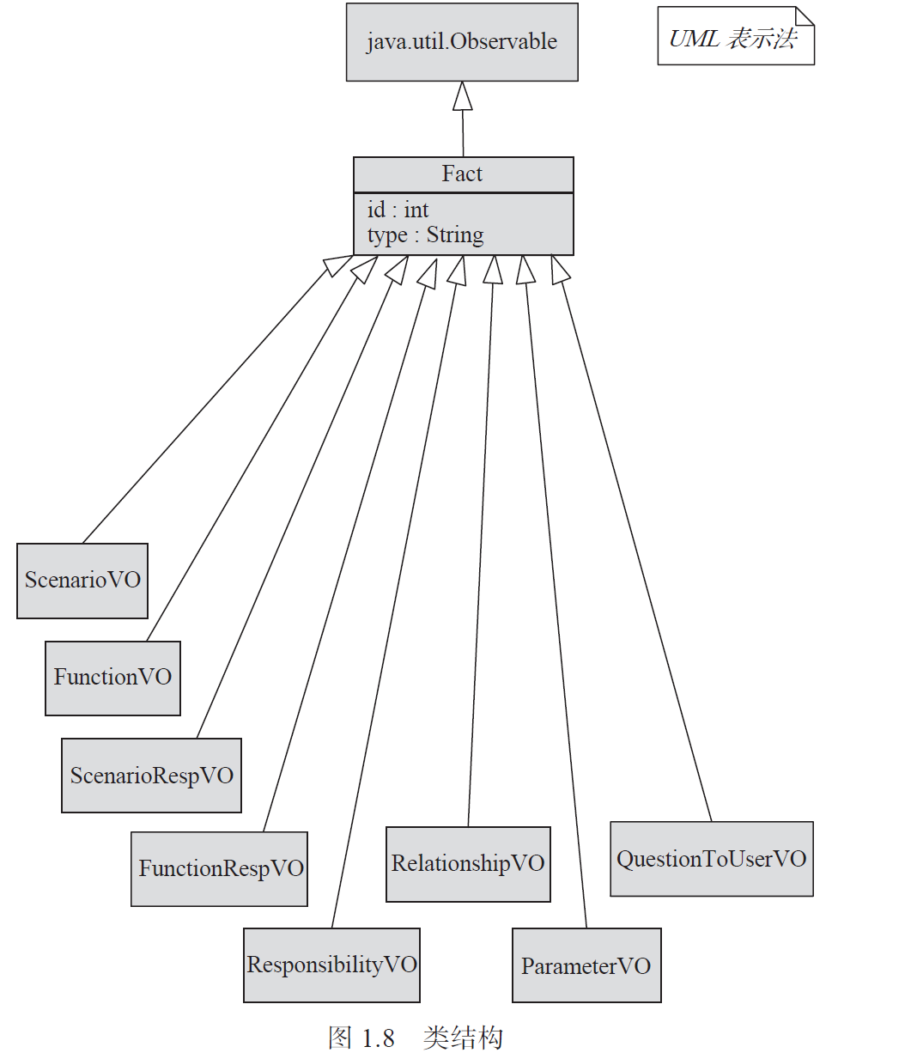

Slide 54
Some Useful Module Structures
Data model structure
The data model describes the static information structure in terms of data entities and their relationships
  For example, in a banking system, entities will typically include Account, Customer, and Loan.
  Account has several attributes, such as account number, type (savings or checking), status, and current balance.

Slide 55
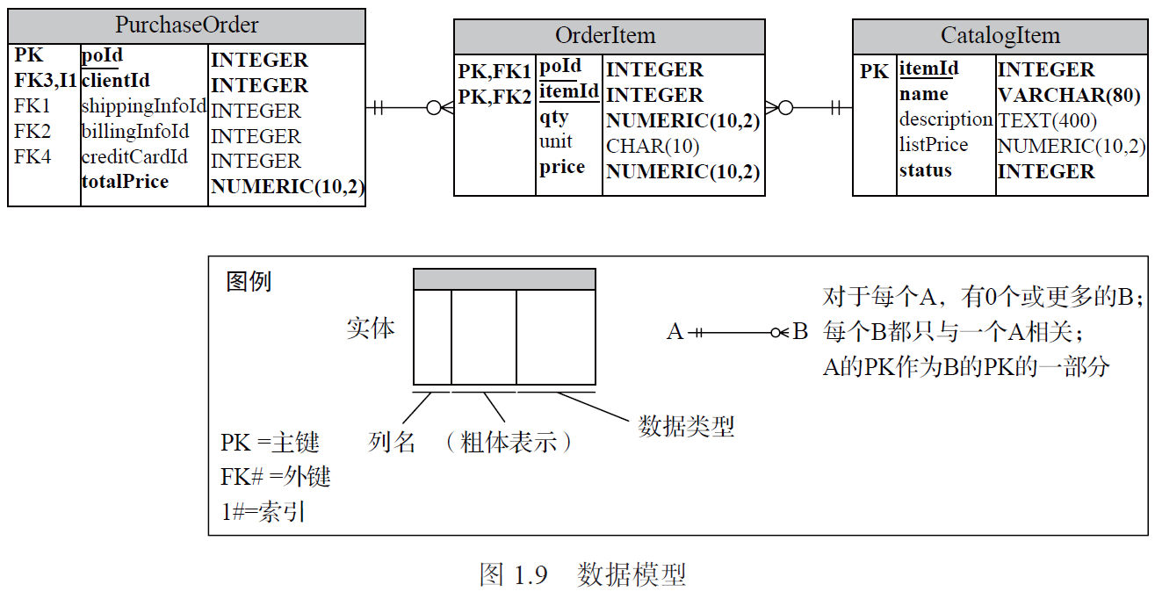

Slide 56
Some Useful C&C Structures
Service structure
  The units are services that interoperate with each other by service coordination mechanisms such as SOAP
  The service structure helps to engineer a system composed of components that may have been developed anonymously and independently of each other.
Notes:
Example of web service: soap, xml and json

Slide 57
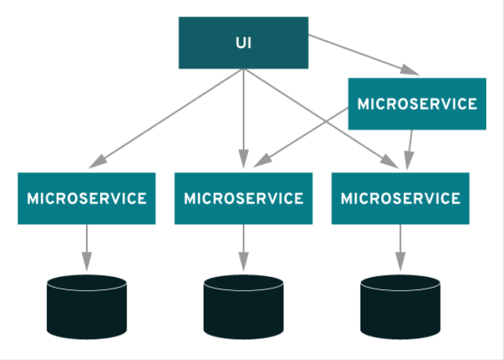

Slide 58
Some Useful C&C Structures
Concurrency structure
  This structure helps determine opportunities for parallelism and the locations where resource contention may occur.
  The units are components
  The connectors are their communication mechanisms.
  The components are arranged into logical threads.

Slide 59
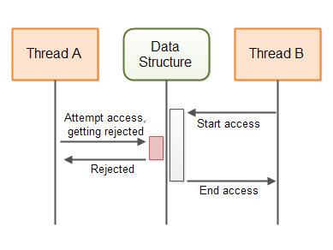

Slide 60
Some Useful Allocation Structures
Deployment structure
The deployment structure shows how software is assigned to hardware processing and communication elements.
The elements are software elements (usually a process from a C&C view), hardware entities (processors), and communication pathways.
Relations are allocated-to, showing on which physical units the software elements reside, and migrates-to if the allocation is dynamic.
This structure can be used to reason about performance, data integrity, security, and availability.
It is of particular interest in distributed and parallel systems.

Slide 61
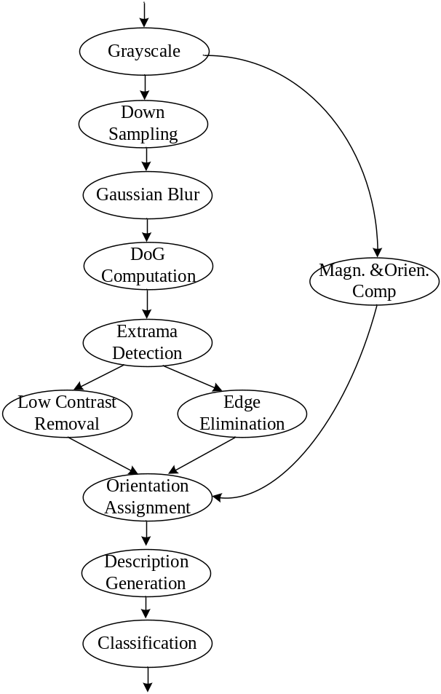
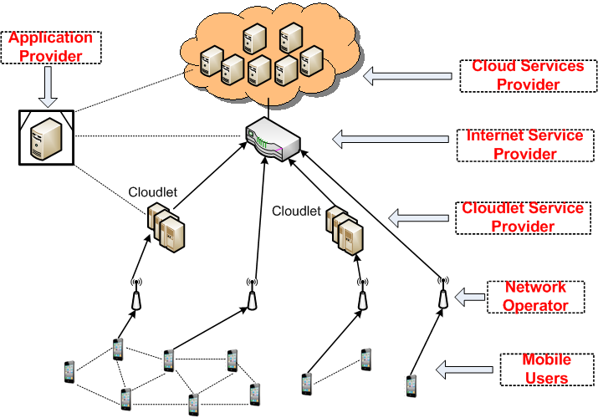
Task allocation in mobile cloud

Slide 62
Some Useful Allocation Structures
Implementation structure
This structure shows how software elements (usually modules) are mapped to the file structure(s) in the system’s development, integration, or configuration control environments.

Slide 63
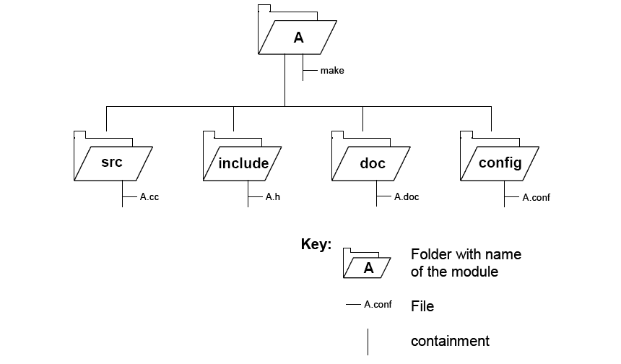
Implementation structure

Slide 64
Some Useful Allocation Structures
Work assignment structure
This structure assigns responsibility for implementing and integrating the modules to the teams who will carry it out.

Slide 65
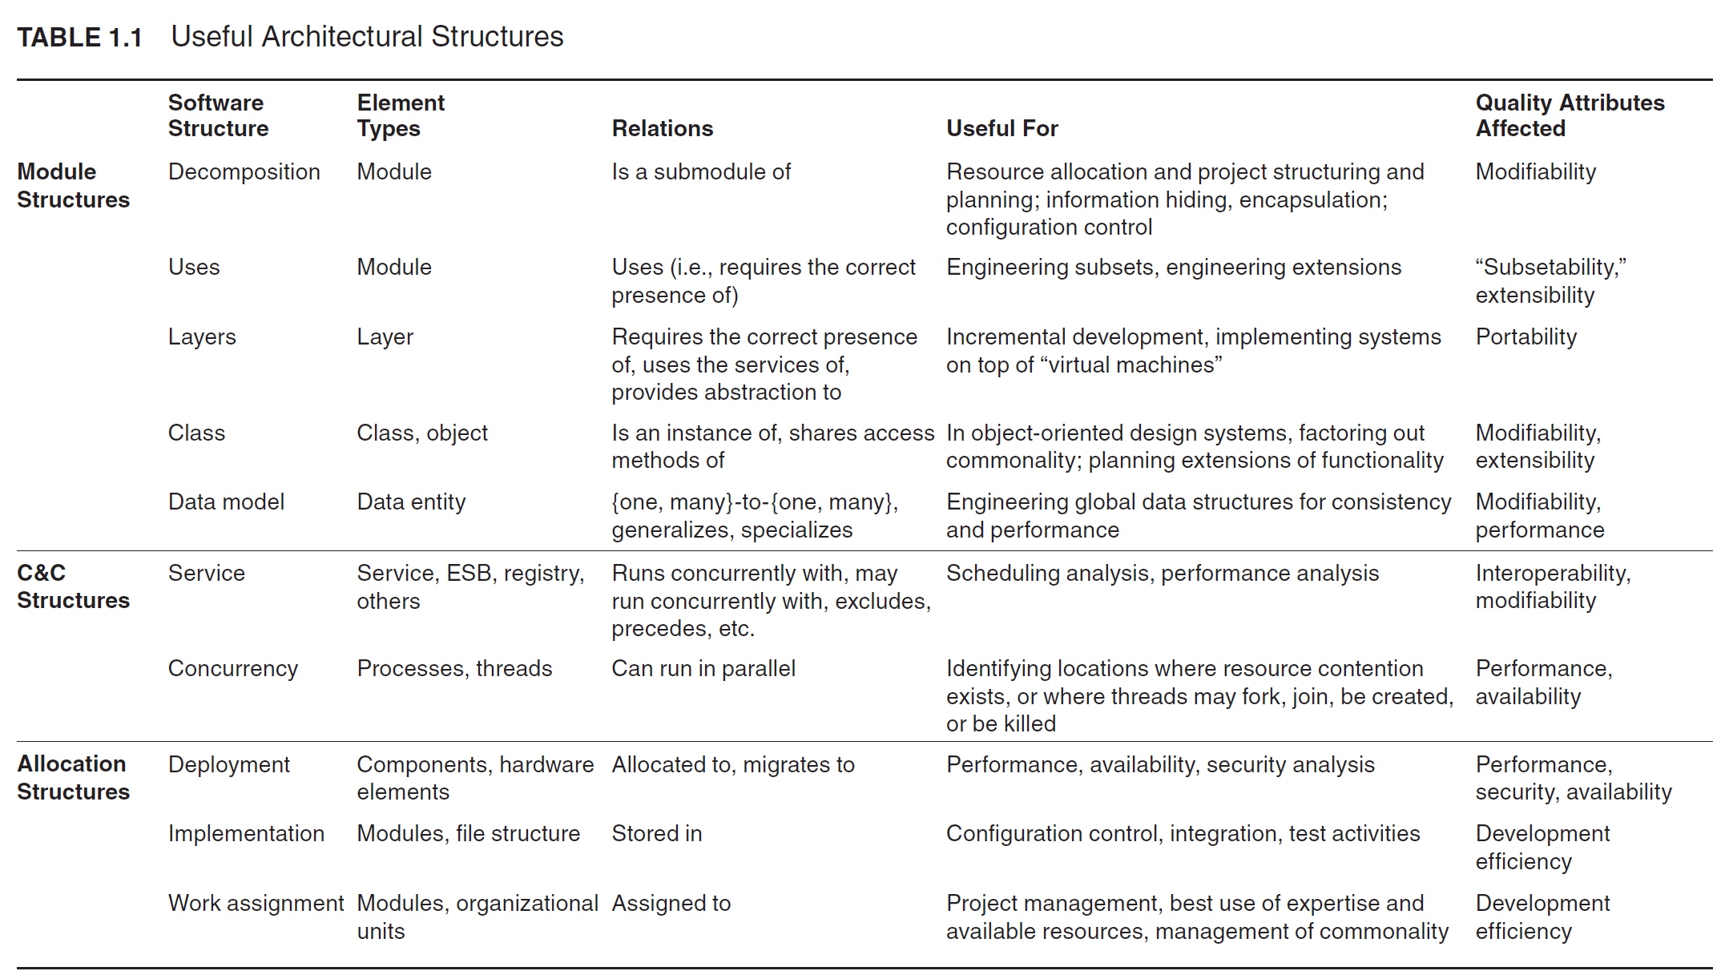

Slide 66
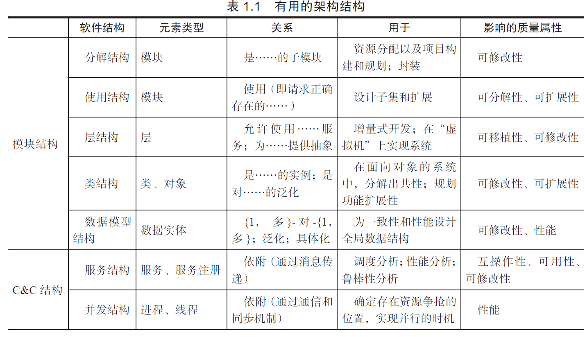
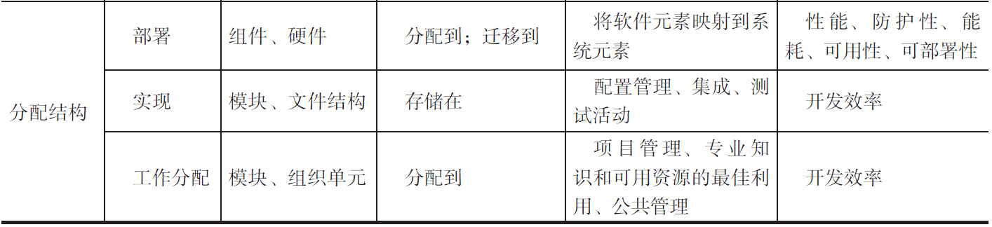

Slide 67
Relating Structures to Each Other
Elements of one structure will be related to elements of other structures, and we need to reason about these relations.
  A module in a decomposition structure may be manifested as one, part of one, or several components in one of the component-and-connector structures.
In general, mappings between structures are many to many.

Slide 68
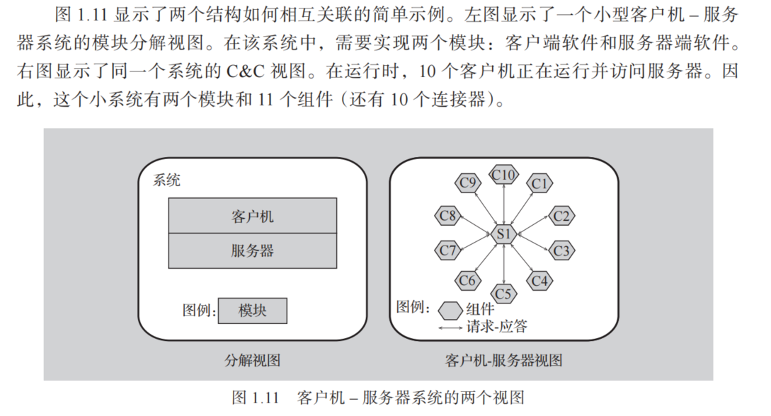
Modules vs. Components

Slide 69
Architectural Patterns
An architectural pattern presents the element types and their forms of interaction used in solving a particular problem.
A common module type pattern is the Layered pattern.
  When the uses relation among software elements is strictly unidirectional, a system of layers emerges.
  A layer is a coherent set of related functionality.

Slide 70
Architectural Patterns
Common component-and-connector type patterns:
Shared-data (or repository) pattern.
  This pattern comprises components and connectors that create, store, and access persistent data.
  The repository usually takes the form of a (commercial) database.
  The connectors are protocols for managing the data, such as SQL.

Slide 71
Shared data pattern
App. server
App. server
App. server
Database

Slide 72
Architectural Patterns
Common component-and-connector type patterns:
Client-server pattern.
  The components are the clients and the servers.
  The connectors are protocols and messages they share among each other to carry out the system’s work.
Peer-to-peer pattern
  E.g. Bittorrent

Slide 73
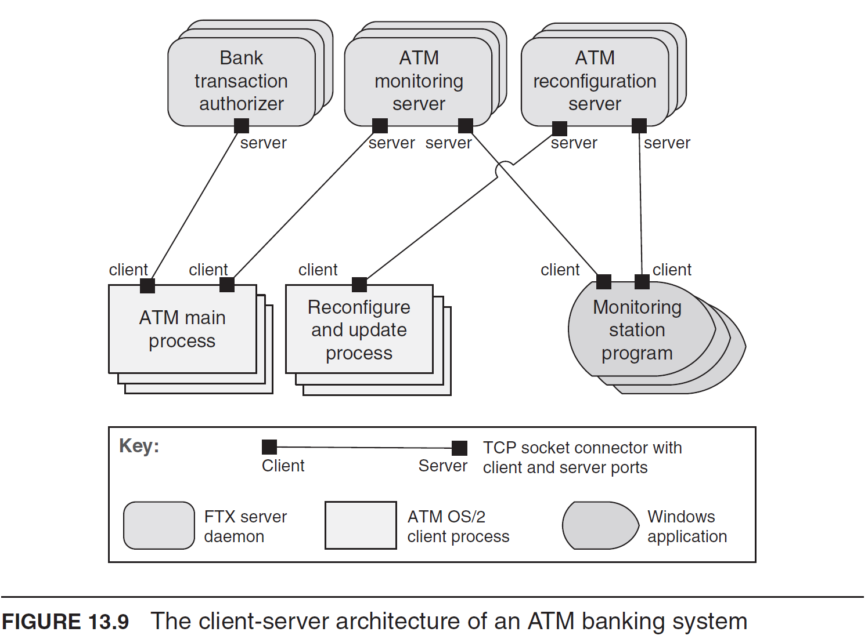

Slide 74
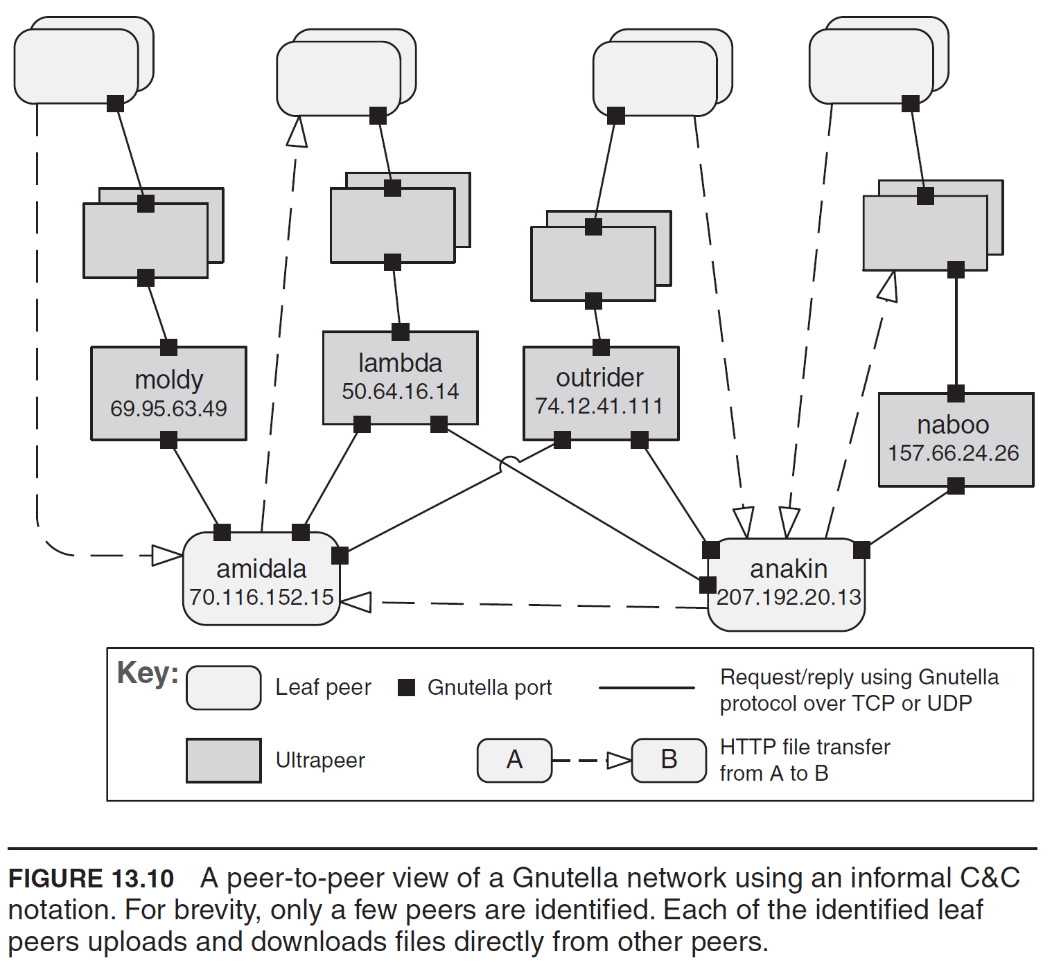
Notes:
BitTorrent: 这是目前最主流的P2P文件共享协议。用户通过一个小的 .torrent 文件来定位资源，并从多个同时拥有该文件的用户那里下载不同的片段，极大地提高了下载速度。
比特币 (Bitcoin): 整个比特币网络是一个P2P网络，每个节点都保存着完整的区块链账本副本，并共同参与交易的验证和新区块的创建（挖矿）。

Slide 75
Architectural Patterns
Common allocation patterns:
Multi-tier pattern
  This pattern specializes the generic deployment (software-to-hardware allocation) structure.
  Describes how to distribute and allocate the components of a system in distinct subsets of hardware and software, connected by some communication medium.
Notes:
Difference between tier and layer
Example of web application

Slide 76
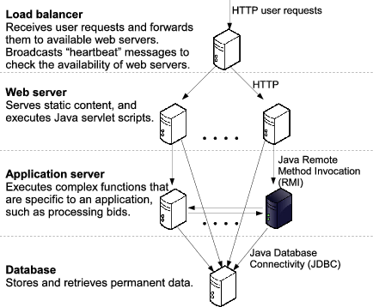

Slide 77
Architectural Patterns
Common allocation patterns:
Competence (能力) center pattern and platform pattern
  These patterns specialize a software system’s work assignment structure.
  In competence center, work is allocated to sites depending on the technical or domain expertise located at a site. For example, user interface design is done at a site where usability engineering experts are located.
  In platform, one site is tasked with developing reusable core assets of a software product line, and other sites develop applications that use the core assets.
Notes:
平台模式是一种强大的软件架构工作分配策略，它通过建立核心资产（平台） 和应用开发的分离与协作，实现了大规模的系统性复用。

Slide 78
What Makes a “Good” Architecture?
There is no such thing as an inherently good or bad architecture.
Architectures can be evaluated but only in the context of specific stated goals.
Architectures are either more or less fit for some purpose
There are, however, good rules of thumb.

Slide 79
Process “Rules of Thumb”
The architecture should be the product of a single architect or a small group of architects with an identified technical leader.
The architect (or architecture team) should base the architecture on a prioritized list of well-specified quality attribute requirements.
The architecture should be documented using views.
The architecture should be evaluated for its ability to deliver the system’s important quality attributes.
The architecture should lend itself to incremental implementation.

Slide 80
Structural “Rules of Thumb”
The architecture should feature well-defined modules
The architecture should never depend on a particular version of a commercial product or tool
Modules that produce data should be separate from modules that consume data.
  This tends to increase modifiability

Slide 81
Structural “Rules of Thumb”
Don’t expect a one-to-one correspondence between modules and components.
Every process should be written so that its assignment to a specific processor can be easily changed, perhaps even at runtime.
The architecture should feature a small number of ways for components to interact.
  The system should do the same things in the same way throughout.

Slide 82
Summary
The software architecture of a system is the set of structures needed to reason about the system, which comprise software elements, relations among them, and properties of both.
A structure is a set of elements and the relations among them.
A view is a representation of a coherent set of architectural elements. A view is a representation of one or more structures.

Slide 83
Some Useful Structures
Module structures
  Decomposition structure
  User structure -> layer pattern
  Class structure
  Data model
Component-and-connector structures
  Service structure
  Concurrency structure
Allocation structures
  Deployment structure
  Implementation structure
  Work assignment structure

Slide 84
Architectural patterns
Module type pattern
  Layered pattern
Component-and-connector type pattern
  Shared data pattern
  Client and server pattern
  Peer to peer pattern
Allocation type pattern
  Multi-tier pattern
  Competence center pattern
  Platform pattern

Slide 85
大作业
[待定]之前组好队，组长将成员名单于[待定]之前发送至邮箱[待定]。落单的人选将随机分组
主题为“AI+软件体系结构”，围绕该主题自行选题。最终打分将成正态分布。
组长于[待定]提交报告，源码，PPT。
考核：报告 (50%)+Presentation (50%)
Presentation安排在15周周日

